Slide 1



Titolo presentazione sottotitolo
Design and Implementation of Mobile Applications
Expire App
Milano, XX mese 20XX
Sorrentino Alessandro - 10746269
Ali Arslan- 10807090
Prof. Baresi Luciano
Notes:
Goodmorning to everyone, I’m Arslan Ali, with my colleague Alessandro Sorrentino, we’ve developed a mobile application called Expire App for the course of Design and Implementation of Mobile Applications with prof Luciano Baresi.

Slide 2
Introduction
A cosa serve la nostra app (motivation behind the app)
Non voglio perdermi cibo che scade in frigo + voglio sapere cosa c’è rimasto a casa da mangiare se non vivo da solo.
Overview generale dell’app (macro funzionalità con supporto mock sotto)
Spiegazione 5 schermate separate + servizi esterni
Multi layout (side by side con versione mobile, dato esperienza diversa ad utenti telefono e tablet)
Slide sul backend (row di simboli di firebase)
Auth
Cloud Firestore
Firebase storage
Cloud messaging + Triggers
/*Servizi implementati
Spoonocular (ricette)
OpenFoodFacts
Google vision API
Scandit
OAuth (google and facebook)*/
Aspetti tecnici: Stato centralizzato nei provider (provider pattern), interface diagram spiegazione interfacciamento componenti (firebaseAuthHelper etc…)
Testing (Unit testing: mockito e injection dal factory constructor, Widget testing provider injection, Monkey testing)

Slide 3

The reasons behind its design
Expire App tells you when your food is going to expire, so that you can use it before it does.
Prof. Baresi Luciano
Notes:
The application has been developed using Flutter, that is an open source framework by Google, to create crossplatform applications.
The main purpose of Expire app, is to track, as the name suggests, the expiration date of the food you buy, by sending reminders.
The real potential of this app is the ability to share your product list with other family members.
But you actually can do much more, for instance you can keep track of your healthy diet, or find personalized recipes or even create shopping lists shared with other family members.
Last but not least, it’s important to remember that
Expire App is available for both users, online and offline.

Slide 4
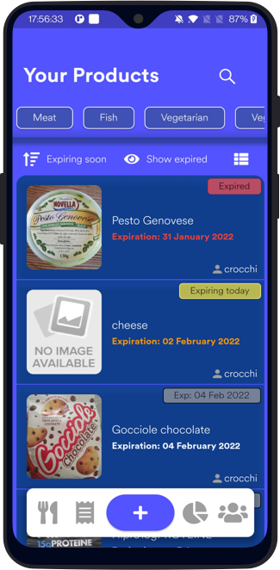
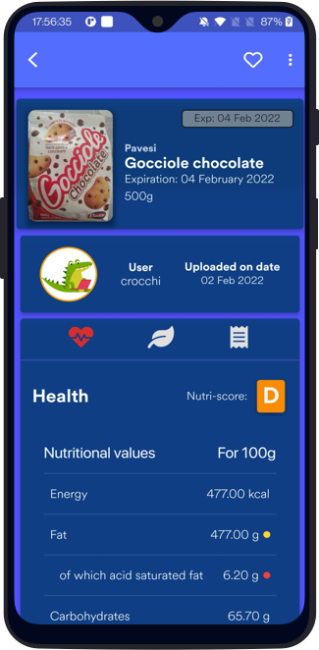
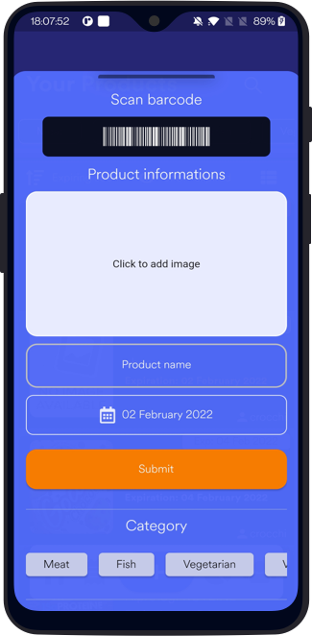



Products Screen
Prof. Baresi Luciano
Notes:
Here follows an overview of the main features of this app
The main use case of this application is to upload product
You can scan the barcode using the camera (Thanks to scandit)
You can also insert everything manually or retrieve data and modify later (also photo)
Data thanks to openFoodFacts
You can scan text (e.g. ingredients) and thanks to cloud vision you have an OCR
Products can be inspected by clicking on them, showing nutritional values, read ecological value, adding it to shopping list and more

Slide 5
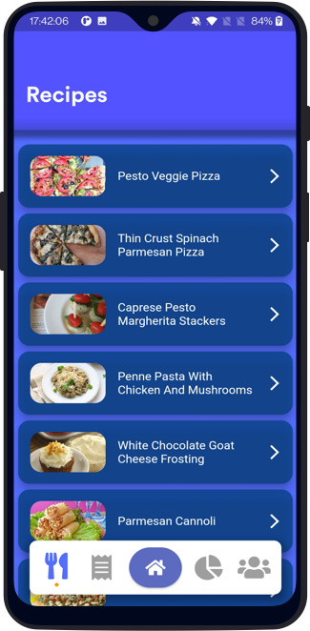
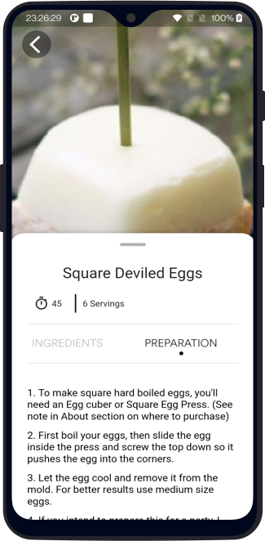

Recipes screen
Prof. Baresi Luciano
Notes:
We’ve seen before how easy it is to add a product.
It can happen sometimes that you have a lot of food about to expire in the fridge and you want to get rid of it
Thanks to spoonacular api you can get tasty recipes
You can inspect each recipe and get details out of it

Slide 6
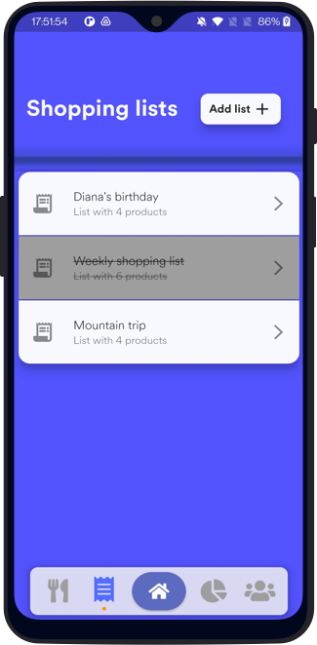
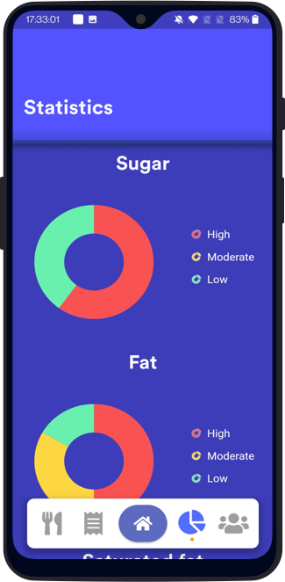
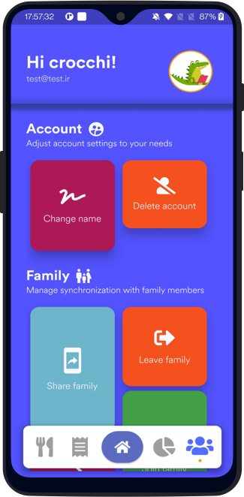
Shopping lists, statistics and user screen
Prof. Baresi Luciano
Notes:
As my colleague was saying before, you can get an overview of how much healty your food is thansk to the statistics screen
Expire app also offers the possibility to create shopping lists, still shared with all your family, to note new products to buy or to buy again products you loved.
It is also possible to mangage personal info and perform actions on the family such as joining a new one, sharing your family and more

Slide 7
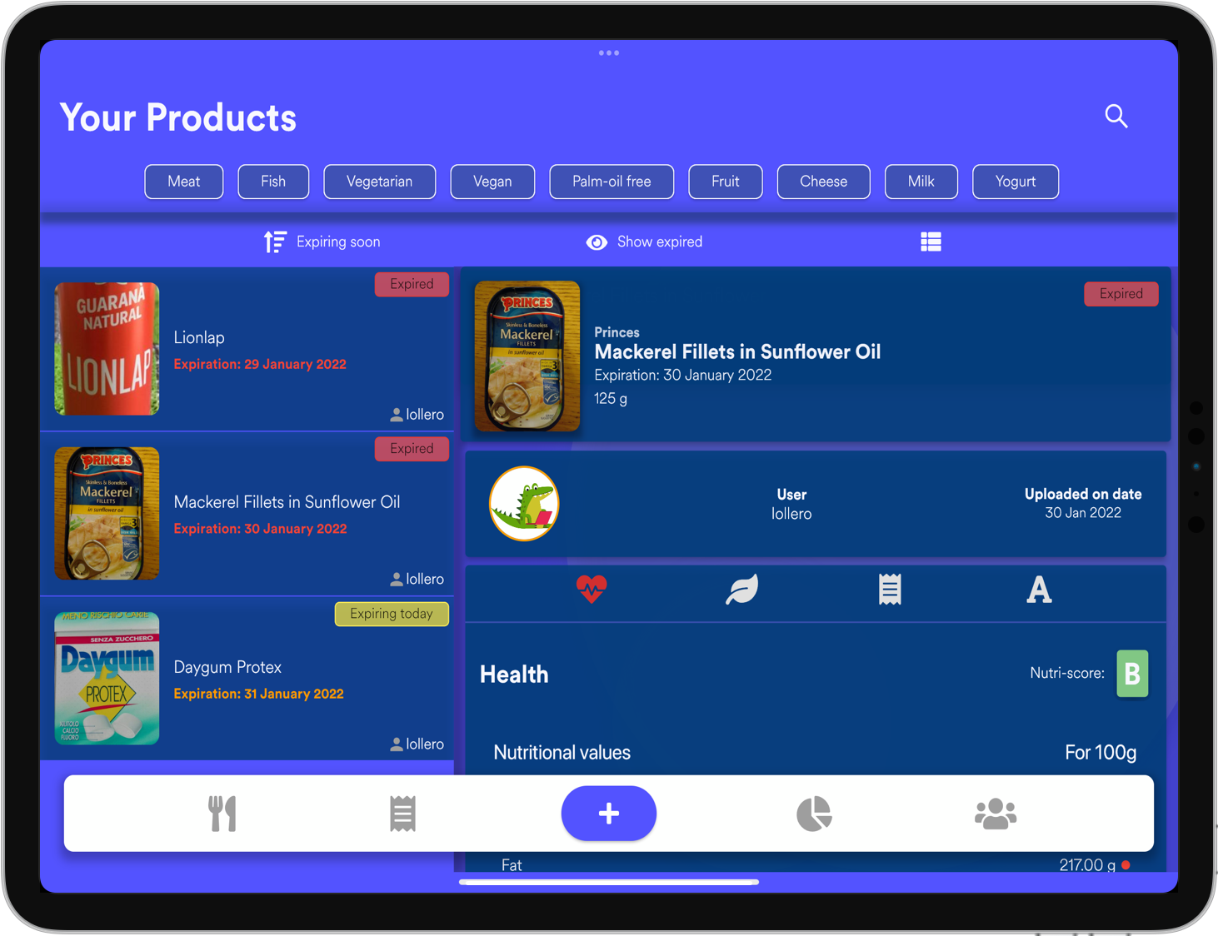
Multi layouts
Prof. Baresi Luciano
Notes:
To give a different user experience, the app has been also developed for multiple screen sizes, and since it’s made using Flutter, it supports both platforms, Android and iOS and even iPadOS.

Slide 8
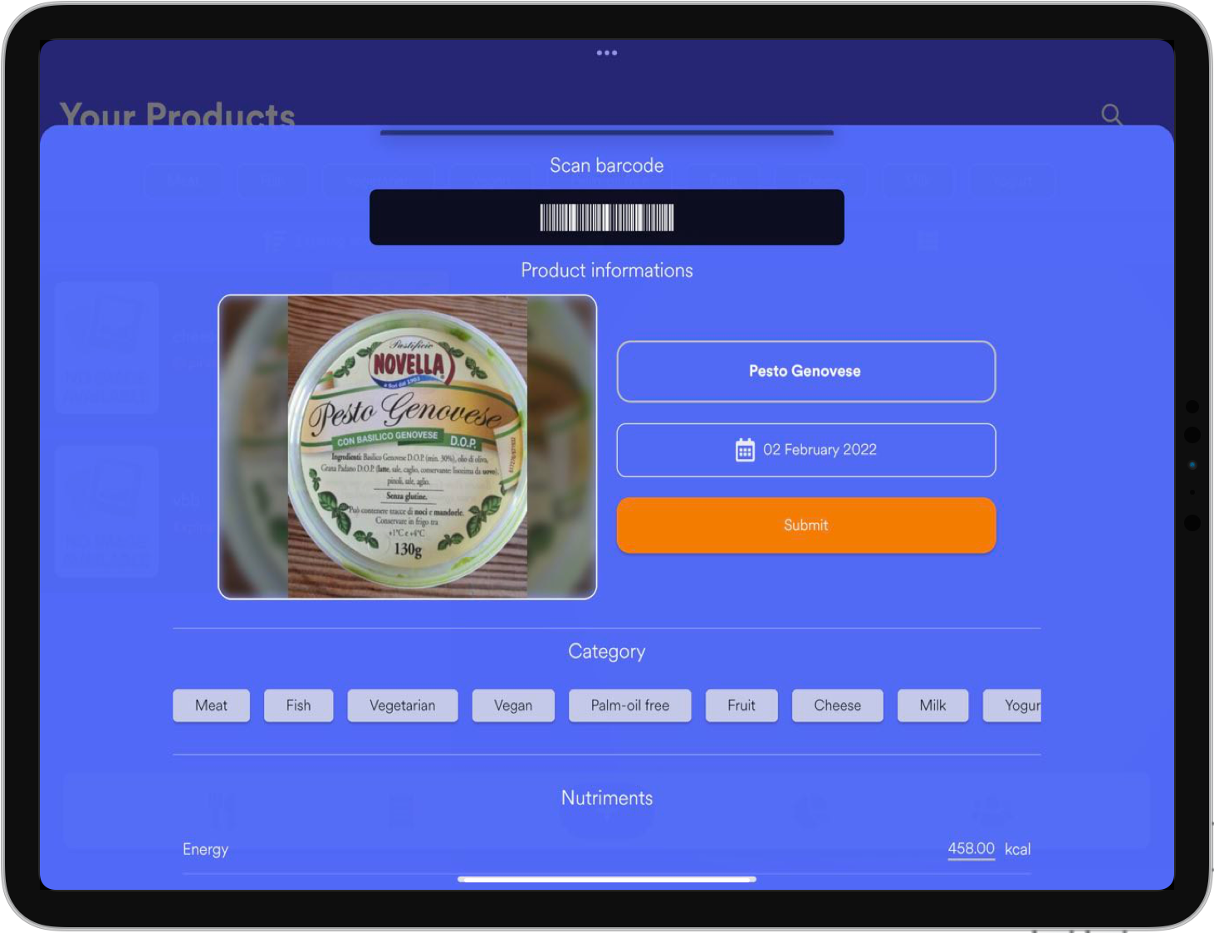
Multi layouts 2
Prof. Baresi Luciano
Notes:
Also in this slide we can see the same activity, the modal where a user can add a product, available on both platforms, an Android device and an iPad.

Slide 9





Backend: Firebase
Firebase Authentication
Cloud Firestore
Cloud Functions
Cloud Messaging
Firebase Storage
Service used to authenticate users
Service used to store application data
Service used to dispatch notifications
Service used to send notifications
Service used to store images
Prof. Baresi Luciano
Notes:
All the functionalities explained before by Alessandro are supported with the help of Firebase as backend service.
We’ve used the following packages, for eg.
Firebase authentication that is the service that manages the authentication of the users,
Cloud functions and cloud messaging used to manage the notifications system used by the application
Cloud firestore is the database where all the data about users and families is stored
And finally Firebase storage, where all the images, taken by the users are stored.

Slide 10
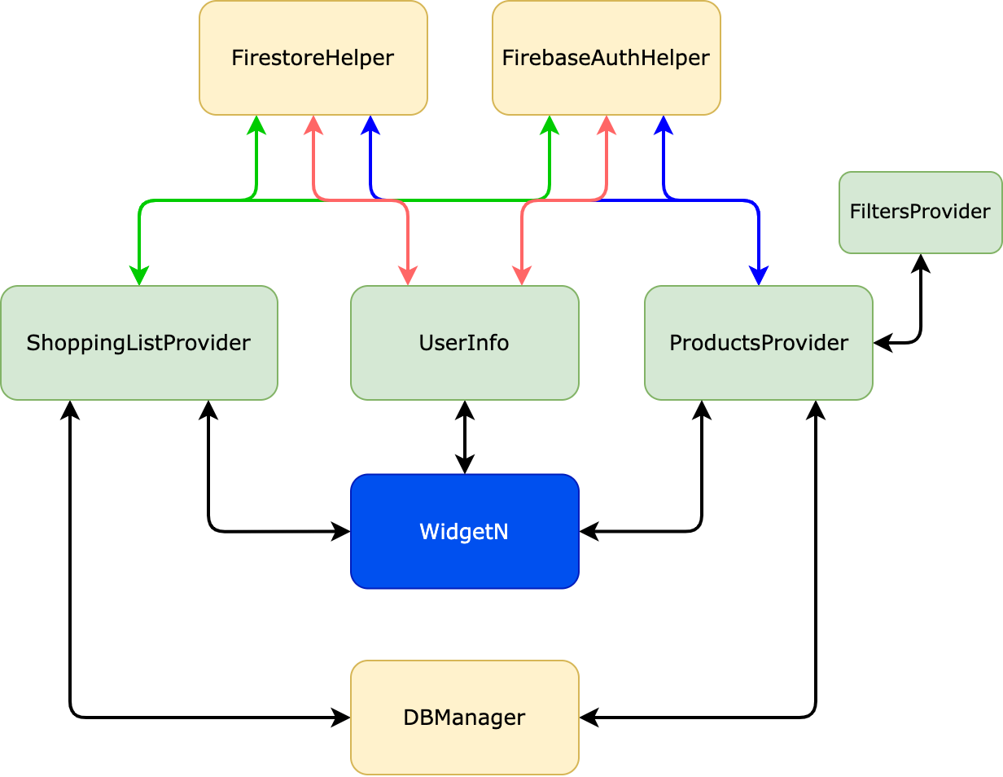
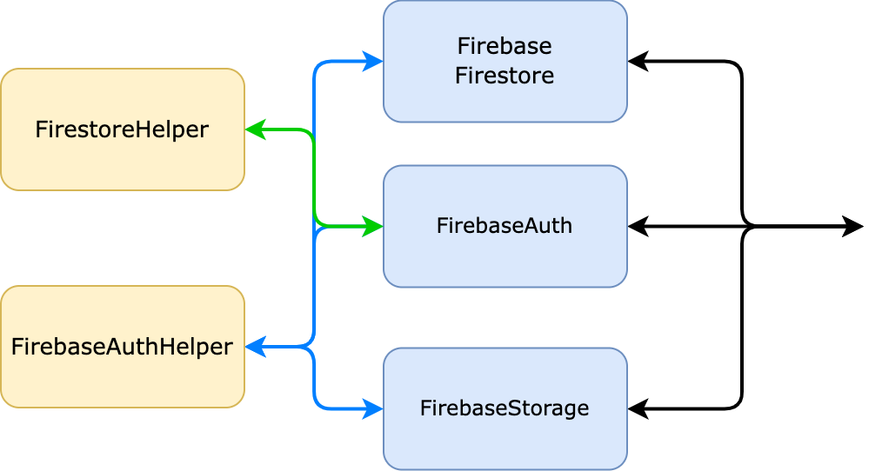

Technical aspects
Provider pattern
Prof. Baresi Luciano
Notes:
it is worth mentioning the main components of the app (providers) -> centralized state in providers (pattern)
also db manager for unregistered user
Middle-components for communication are the firestorehelper and fireabaseauthhelper

Slide 11

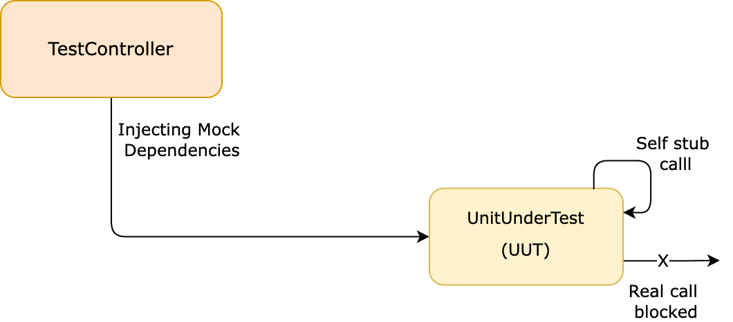
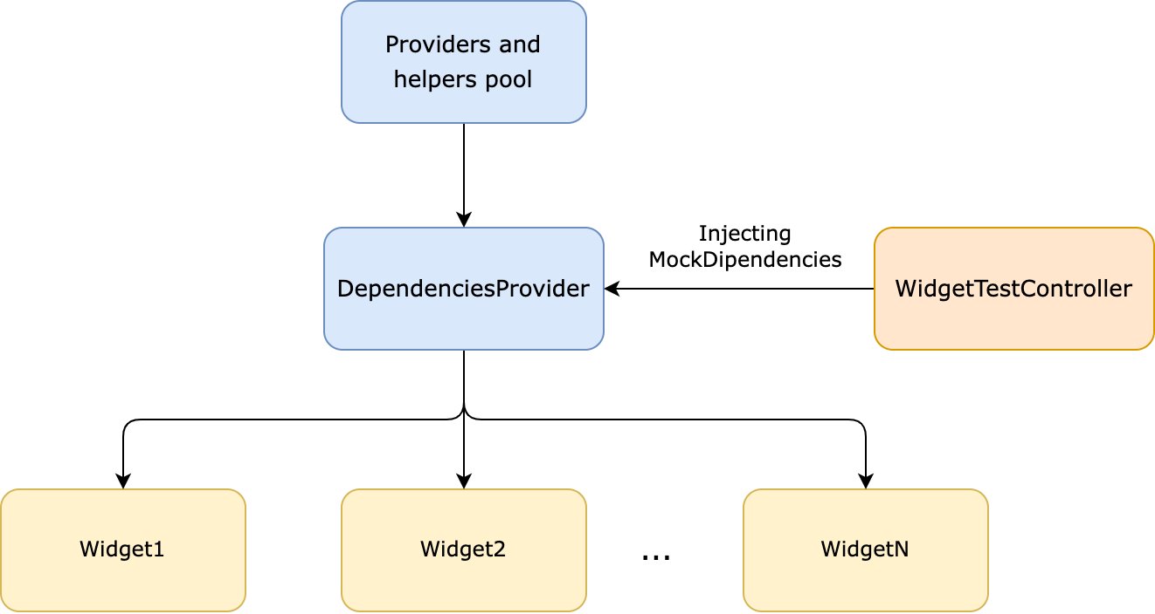
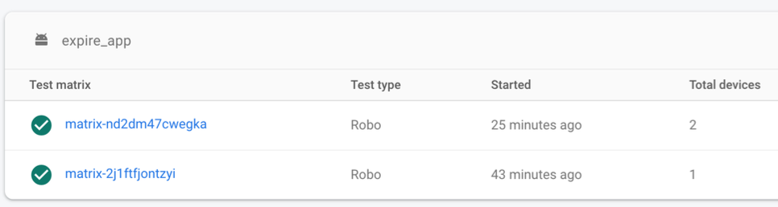
Testing
Unit Testing
Widget Testing
Monkey Testing
Prof. Baresi Luciano
Notes:
We performed three types of testing: Unit testing, widget testing and monkey testing
Visible testing (not secure)
Unit testing
Used mockito which is a library to create stubs and perform unit testings
Needed a way to use mocks instead of real calls, modified constructors in order to be able to inject mock dependencies (and avoid static initialization of firebase)
- Widget testing
- is used to check that the UI behaves as expected from human interaction.
- tedious to modify all constructors of widget to be ablet o inject dependencies, need different strategy
- user provider of dependencies parent of all widgets in order to be able to dynamically inject dependencies if needed
- Monkey testing was offered by firebase lab

Slide 12
Testing
Thanks for your attention
Prof. Baresi Luciano

